Slide 1

Predicting Stock Returns With Ratio Analysis and Predictive Regression
Eric Schneider

Slide 2

Project Overview
The main objective for this project was to create a model with the capacity to predict the returns for a publicly traded stock utilizing financial ratios collected from annual financial statements.
This project included the building of a ratio dataset compiled from data scraped from NYSE financial reports provided by the YFinance library
There were a vast number of models which were tested on the dataset, with the leading model reading a standard error of 3%.

Slide 3
Building the dataset
The Yfinance library provided a way to call annual financial reports from a list of companies sold on the NYSE
Once a set of statements were pulled, the necessary accounting values for each ratio were identified and the case was added to the dataset
Of the roughly 8000 companies listed on the exchange, yfinance was able to pull information from roughly 4500 across roughly two one-year periods. This yielded a final dataset just over 8000 rows in size.

Slide 4
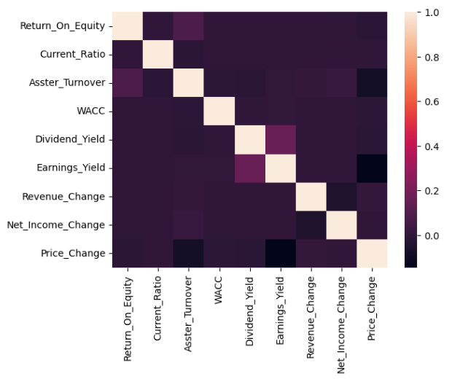
Data Analysis
What is most important in the dataset is the lack of correlation among variables. This ensures that each variable can maximize its contribution to the model.
There were very few outliers in the data, compiling about .5% of the dataset. These were removed to prioritize the accuracy of the data
Additionally, the variables each tended to take on one of two distributions:
Normal Distribution
Tweedie Distribution

Slide 5
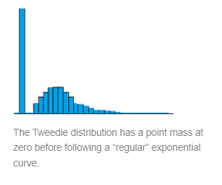
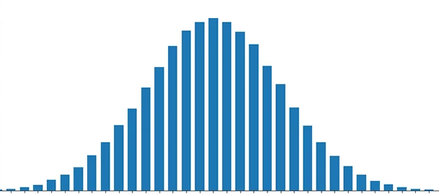

Slide 6
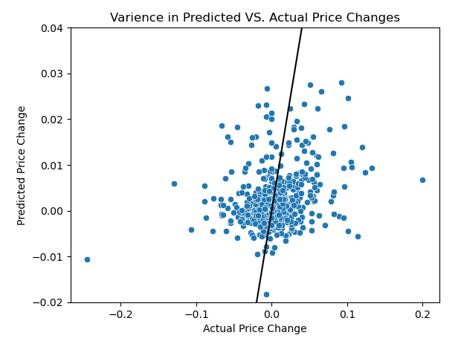
Methods/modeling
There was a similar process for testing and evaluating each model which was used:
The dataset was split into x and y data, before being split into train, test, and evaluation datasets. The optimal size for each data frame was 77.5% for training, 14% for testing, and 8.5% for evaluation.
Missing data was imputed in all three x data frames using the K Nearest Neighbor Imputer. The Y data, being univariate, was imputed using mean based imputation
An initial testing model was run to identify potential to better optimize the model
A sensitivity analysis was run to find the optimal values of each parameter for the model
The final evaluation model was run using the evaluation data frame.
The standard error of the residuals were used to determine the relative accuracy of the model. In practice, it represents the amount that the predicted returns tend to differ from the actual returns.

Slide 7
Honorable Mentions of Models
Bagging Meta Estimator – 3.102%
Bayesian Ridge – 3.677%
Gradient Boosting – 3.535%
Histogram Based Gradient Boosting – 3.529%
Isotonic – 3.185% (Univariate Regression Only)
K Nearest Neighbor – 3.239%
Lasso – 3.488%
Cross Validation Lasso – 3.678%
Multi-Layer Perceptron – 10.847%
Random Forest - 3.491%

Slide 8
Ms. Congeniality – Gaussian Process
The Gaussian Process utilizes multivariate gaussian based distributions to estimate the response variable.
This model is best utilized with positive functions. Since the data used in this project does not fit into a positive function, the Gaussian Process proved to be very inaccurate.
Comically inaccurate in fact, being evaluated as having a standard error of 760.117%

Slide 9
Most Interesting – Passive Aggressive
This linear model prioritizes the act of being ‘passive’ in rewarding the model for correct answers but being very ‘aggressive’ in correcting the model’s mistakes.
This model proved at times to be the most accurate. However, the model randomizes its passive-aggressive nature, introducing a high amount of variation to the standard error.
After running the model 10,000 times, I found that the average standard error was 3.711%.

Slide 10
Most Unique – Tweedie Regression
Tweedie regression is a form of linear model which utilizes the Tweedie distribution as opposed to the normal distribution used in linear regression.
The use of this model had positive effects on the Dividend yield and earnings yield variables, which follow the Tweedie distribution. However, it had a negative effect on the normally distributed variables.
In all, the Tweedie Regression model had a standard error of 3.678%. However, it can be proven useful, given the ability to utilize multiple regression models at once

Slide 11
Most Complex – Voting Regression
Voting regression is an ensemble model, meaning it merges multiple models into a single set, and averages their response values to maximize accuracy.
This model utilized 7 of the most accurate models used previously. They were KNN, Random Forest, Tweedie, Lasso, XGBoost, Bayesian Ridge, and Bagging Meta estimator. Each component-model was set to its most optimal parameters.
In all, Voting Regression proved to be the second most accurate model, yielding a standard error of 3.103%.

Slide 12
Best Model – XGBoost
XGBoost, otherwise known as Extreme Gradient Boosting, is a scalable, distributed gradient-boosted decision tree (GBDT) open-source machine learning library.
This model is best optimized for performance and accuracy in multi variable based regression, such as with the dataset of this project. This model also prioritizes regularization of data, which helps prevent overfitting.
XGBoost is a relatively new model, the only model in this project not found in scikitlearn, but instead its own specific library.
XGBoost proved to be the most accurate model, yielding a standard error of 3.074%.

Slide 13
From Preliminary to Final Results
The main changes which occurred between the preliminary and final models were a shift from using mean based imputation to KNN Imputation. This lowered the standard error of the XGBoost model by about .01% (.3% reduction).
Additionally, a change was made to the original dataset to remove extreme outliers in the data, based on outliers in the response variable.

Slide 14

Conclusion
The final regression model showed a standard error of 3.074%, with XGBoost being most accurate, followed by Voting Regression (3.103%), Bagging Meta Estimator (3.102%), and K Nearest Neighbor (3.239%).
A larger dataset with a higher standard deviation of actual percentage returns, utilizing a wider array of companies for a longer period could yield better results through the same method of regression.

Slide 15

Reflection
In all, this class taught me about how to scrape data from online databases, as well as how to pip install libraries and best optimize regression models.
I am a lot more confident in my abilities with Pandas and SciKitLearn now.
The team projects also helped me refresh my knowledge of various topics such as MySQL, Operations Research, and Dataset Cleaning.
Also, if you think AI is perfect, this is the accompanying image the designer gave me for this slide.

Slide 16
Questions?

